Slide 1

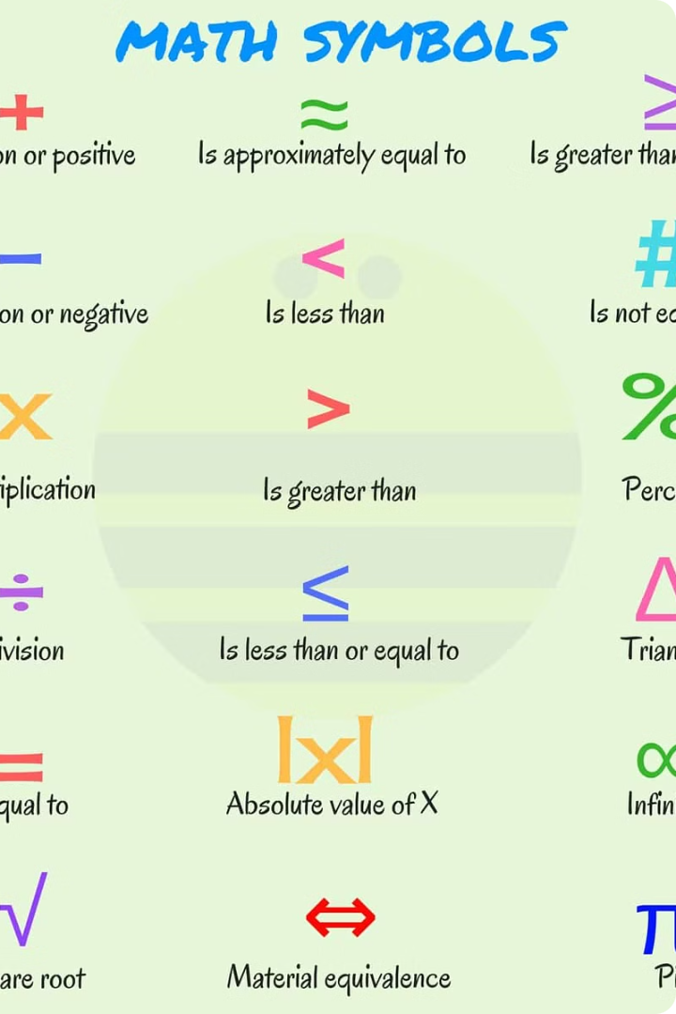
Euler Totient Function
The Euler totient function, denoted by φ(n), counts the number of positive integers less than or equal to n that are relatively prime to n. This function has wide-ranging applications in number theory, cryptography, and computer science.

Slide 2
Properties of the Euler Totient Function
The Euler totient function exhibits several important properties that make it useful in various mathematical contexts.
1
Multiplicativity
2
Formula for φ(p)
If a and b are relatively prime, then φ(ab) = φ(a) * φ(b).
If p is a prime number, then φ(p) = p - 1.
3
Sum of φ(d) over d dividing n
4
φ(n) is even for n > 2
The sum of φ(d) over all positive divisors d of n equals n.
This property is due to the fact that every integer greater than 2 has at least two factors, 1 and itself.

Slide 3
Calculating the Euler Totient Function
Prime Factorization Method
Iterative Method
Recursive Method
This method involves factoring the number n into its prime factorization, then applying the formula for φ(n).
This method involves iterating through the numbers less than or equal to n and checking for their relative primality with n.
This method utilizes the recursive formula φ(n) = n * (1 - 1/p1) * (1 - 1/p2) * ... * (1 - 1/pk).

Slide 4

Applications of the Euler Totient Function
Modular Arithmetic
Number Theory
Used to find the multiplicative inverse of an element in a modular ring.
Used to study the properties of numbers and their relationships.
1
2
3
4
Cryptographic Algorithms
Computer Science
Used in encryption algorithms such as RSA to secure communication.
Used in efficient algorithms for tasks involving prime numbers and modular arithmetic.

Slide 5
Euler Totient Function
In arithmetic modulo n
complete set of residues is: 0..n-1
reduced set of residues is those numbers (residues) which are relatively prime to n
eg for n=10,
complete set of residues is {0,1,2,3,4,5,6,7,8,9}
reduced set of residues is {1,3,7,9}
Euler Totient Function ø(n) is the number of elements in reduced set of residues
In number theory, Euler's totient function counts the positive integers up to a given integer n that are relatively prime to n.

Slide 6
Find the Euler totient number of the following :
9
15
37
100

Slide 7
Cryptographic Applications of the Euler Totient Function
The Euler totient function is a cornerstone of modern cryptography, enabling secure communication and data protection.
RSA Algorithm
Used for public-key encryption and digital signatures.
Diffie-Hellman Key Exchange
Used for secure key exchange over an insecure channel.
Elliptic Curve Cryptography
Used for secure communication with smaller key sizes.

Slide 8



Euler's Theorem and Fermat's Little Theorem
Euler's Theorem and Fermat's Little Theorem are closely related to the Euler totient function and play fundamental roles in number theory.
Euler's Theorem
Fermat's Little Theorem
Relationship
For any integer a relatively prime to n, a^φ(n) ≡ 1 (mod n).
If p is a prime number and a is an integer not divisible by p, then a^(p-1) ≡ 1 (mod p).
Fermat's Little Theorem is a special case of Euler's Theorem when n is a prime number.

Slide 9
Euler's Theorem
Examples:
a=3;n=10; ø(10)=4;
hence 3⁴ = 81 = 1 mod 10
a=2;n=11; ø(11)=10;
hence 2¹⁰ = 1024 = 1 mod 11
Verify Euler’s Theorem for previous examples for a=11

Slide 10
Primality Testing
Primality testing involves determining whether a given number is a prime number or not.
Properties of Prime Numbers:
Any positive odd integer >3 can be expressed as ,
n-1 = 2^{k}q, where q is odd and k>1
If p is prime and 0<a<p, then
a² mod p = 1 iff a mod p = 1
Or , a mod p = 1 mod p = p-1
Let p be prime and p>2, then
p-1 = 2^{k}q, q is odd & k > 0

Slide 11
Miller Rabin Algorithm
a test based on Fermat’s Theorem
algorithm is:
TEST (n) is:
1. Find integers k, q, k > 0, q odd, so that (n–1)=2^{k}q
2. Select a random integer a, 1<a<n–1
3. if a^{q} mod n = 1 then return (“maybe prime");
4. for j = 0 to k – 1 do
5. if (a^{2jq} mod n = n-1(or 1))
then return(" maybe prime ")
6. return ("composite")

Slide 12
Verify the primality of following numbers using Miller Rabin algorithm:
49
73
113

